Slide 1


Slide 2

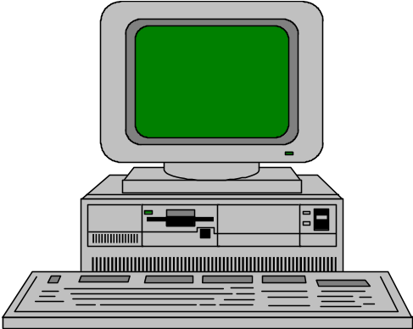


a client, a server, and network
Client
Request
Server
Network
Result
Client machine
Server machine

Slide 3
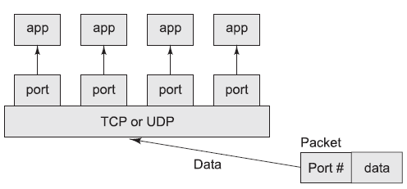
TCP/UDP mapping of incoming packets to appropriate port/process

Slide 4
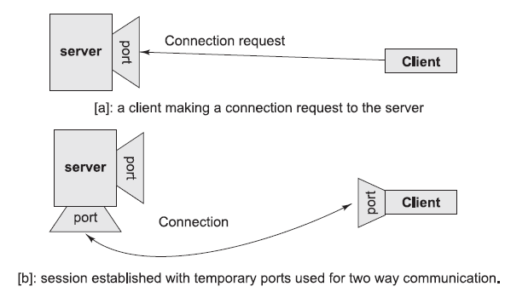

Slide 5
A server (program) runs on a specific computer and has a socket that is bound to a specific port. The server listens to the socket for a client to make a connection request. If everything goes well, the server accepts the connection. Upon acceptance, the server gets a new socket bound to a different port.
It needs a new socket (consequently a different port number) so that it can continue to listen to the original socket for connection requests while serving the connected client.

Slide 6
Data is transmitted across the Internet in packets of finite size called datagrams.
Each datagram contains a header and a payload.
Fragmentation and reassembly.
Retransmission
out of order and reordered
Sockets shield the programmer from low-level details of the network, such as error detection, packet sizes, packet retransmission, network addresses, and more.

Slide 7
The TCP and UDP protocols use ports to map incoming data to a particular process running on a computer. Port is represented by a positive (16-bit) integer value. Some ports have been reserved to support common/well known services:
ftp 21/tcp
telnet 23/tcp
smtp 25/tcp
login 513/tcp
http 80/tcp,udp
https 443/tcp,udp

Slide 8

A socket is a connection between two hosts.
It can perform seven basic operations:
  Connect to a remote machine
  Send data
  Receive data
  Close a connection
  Bind to a port
  Listen for incoming data
  Accept connections from remote machines on the bound port

Slide 9
client sockets
The program creates a new socket with a constructor.
The socket attempts to connect to the remote host.
Once the connection is established, the local and remote hosts get input and output streams from the socket and use those streams to send data to each other.
When the transmission of data is complete, one or both sides close the connection.

Slide 10

Telnet connect to port 23. To connect to servers on different ports, specify the port telnet localhost 25
SMTP port, on the local machine
SMTP is the protocol used to transfer email between servers or between a mail client and a server.
interact with an SMTP server through commands

Slide 11
telnet localhost 25
Trying 127.0.0.1 ...
Connected to localhost.sunspot.noao.edu.
HELO sunspot.noao.edu
250 Ok
MAIL FROM: bart
250 bart... Sender ok
RCPT TO: local@sunspot.noao.edu
250 local@sunspot.noao.edu... Recipient ok
DATA
354 Enter mail, end with "." on a line by itself
Type the message here
.
250 Mail accepted
QUIT
221 flare.sunspot.noao.edu delivering mail. Connection closed by foreign host.

Slide 12

java.net.Socket class
Ports - from 0 to 65,535.
Constructors
  public Socket(String host, int port) throws UnknownHostException, IOException

Slide 13
try {
Socket toOReilly = new Socket("www.oreilly.com", 80);
// send and receive data...
}
catch (UnknownHostException ex) { System.err.println(ex);}
catch (IOException ex) { System.err.println(ex); }

Slide 14

1. Find out which of the first 1,024 ports seem to be hosting TCP servers on a specified host

Slide 15
import java.net.*;
import java.io.*;
public class LowPortScanner {
public static void main(String[] args) {
String host = "localhost";
if (args.length > 0) {
host = args[0];
}
for (int i = 1; i < 1024; i++) {
try {
Socket s = new Socket(host, i);
System.out.println("There is a server on port " + i + " of "
+ host);
}
catch (UnknownHostException ex) {
System.err.println(ex);
break;
}
catch (IOException ex) { }
} } }

Slide 16
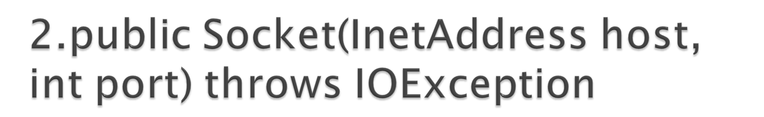
try {
InetAddress oreilly = InetAddress.getByName("www.oreilly.com");
Socket oreillySocket = new Socket(oreilly , 80);
// send and receive data...
}
catch (UnknownHostException ex) { System.err.println(ex); }
catch (IOException ex) { System.err.println(ex); }

Slide 17
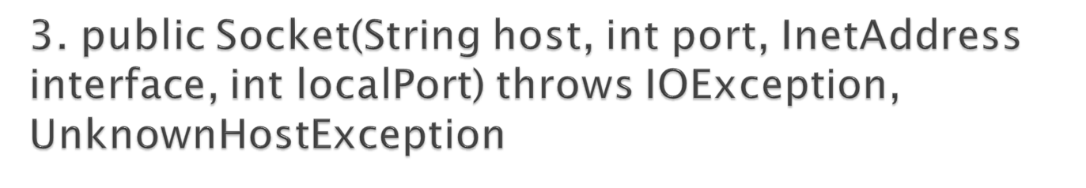
try {
InetAddress inward = InetAddress.getByName("router");
Socket socket = new Socket("mail", 25, inward, 0);
// work with the sockets...
}
catch (UnknownHostException ex) { System.err.println(ex); }
catch (IOException ex) { System.err.println(ex); }

Slide 18
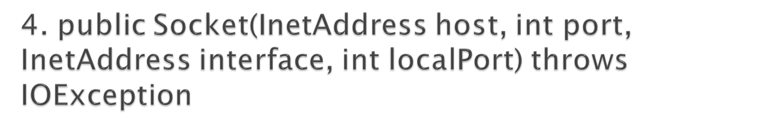
try {
InetAddress inward = InetAddress.getByName("router");
InetAddress mail = InetAddress.getByName("mail");
Socket socket = new Socket(mail, 25, inward, 0);
// work with the sockets...
}
catch (UnknownHostException ex) { System.err.println(ex); }
catch (IOException ex) { System.err.println(ex); }

Slide 19
5.protected Socket( )
installs the default SocketImpl (from either the factory or a java.net.PlainSocketImpl).
6. protected Socket(SocketImpl impl)
7. public Socket(Proxy proxy)

Slide 20

public InetAddress getInetAddress( )
public int getPort( )-tells which port the Socket is connected to on the remote host
public int getLocalPort( )-To find the port number for the local end of a connection
public InetAddress getLocalAddress( )-tells which network interface a socket is bound to

Slide 21
Get a socket's information

Slide 22
import java.net.*;
import java.io.*;
public class SocketInfo {
public static void main(String[] args) {
for (int i = 0; i < args.length; i++) {
try {
Socket theSocket = new Socket(args[i], 80);
System.out.println("Connected to " + theSocket.getInetAddress() + " on port " + theSocket.getPort() + " from port " + theSocket.getLocalPort() + " of " + theSocket.getLocalAddress());
}
catch (UnknownHostException ex) { System.err.println("I can't find " + args[i]); }
catch (SocketException ex) { System.err.println("Could not connect to " + args[i]); }
catch (IOException ex) { System.err.println(ex); }
}
}
}

Slide 23
public InputStream getInputStream( ) throws IOException - returns an input stream that can read data from the socket into a program
public OutputStream getOutputStream( ) throws IOException - returns a raw OutputStream for writing data from your application to the other end of the socket

Slide 24
Echo client
PrintWriter out = null;
BufferedReader networkIn = null;
try {
Socket theSocket = new Socket(hostname, 7);
networkIn = new BufferedReader( new InputStreamReader(theSocket.getInputStream()));
BufferedReader userIn = new BufferedReader( new InputStreamReader(System.in));
out = new PrintWriter(theSocket.getOutputStream());
System.out.println("Connected to echo server");
while (true) {
String theLine = userIn.readLine();
if (theLine.equals(".")) break;
out.println(theLine);
out.flush();
System.out.println(networkIn.readLine());
}
}

Slide 25

public void close( ) throws IOException
Half-closed sockets
  public void shutdownInput( ) throws IOException
  public void shutdownOutput( ) throws IOException

Slide 26
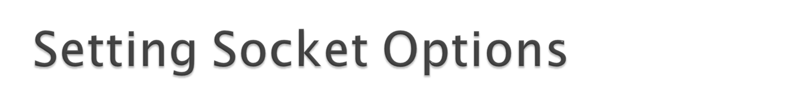
TCP_NODELAY- ensures that packets are sent as quickly as possible regardless of their size
SO_BINDADDR
SO_TIMEOUT
SO_LINGER - specifies what to do with datagrams that have not yet been sent when a socket is closed
SO_SNDBUF
SO_RCVBUF
SO_KEEPALIVE - just to make sure the server hasn't crashed
OOBINLINE - sends a single byte of "urgent" data

Slide 27

public void setTcpNoDelay(boolean on)
public boolean getTcpNoDelay( )
public void setSoLinger(boolean on, int seconds)
public int getSoLinger( )
public void setSoTimeout(int milliseconds)
Public int getSoTimeout( )

Slide 28
public void setReceiveBufferSize(int size) throws IllegalArgumentException
public int getReceiveBufferSize( )
public void setSendBufferSize(int size) throws IllegalArgumentException
public int getSendBufferSize( )
public void setKeepAlive(boolean on)
public boolean getKeepAlive( )

Slide 29
public void setOOBInline(boolean on)
public boolean getOOBInline( )
public void sendUrgentData(int data) throws IOException
public void setReuseAddress(boolean on)
public boolean getReuseAddress( )

Slide 30

public int getTrafficClass( ) throws SocketException
public void setTrafficClass(int trafficClass) throws SocketException
  0x02: Low cost
  0x04: High reliability
  0x08: Maximum throughput
  0x10: Minimum delay
Ex:
  Socket s = new Socket("www.yahoo.com", 80); s.setTrafficClass(0x02);

Slide 31

public class SocketException extends IOException
public class BindException extends SocketException
public class ConnectException extends SocketException
public class NoRouteToHostException extends SocketException
public class ProtocolException extends IOException

Slide 32

public SocketAddress getRemoteSocketAddress( )
public SocketAddress getLocalSocketAddress( )
public void connect(SocketAddress endpoint) throws IOException
public void connect(SocketAddress endpoint, int timeout) throws IOException

